Slide 1
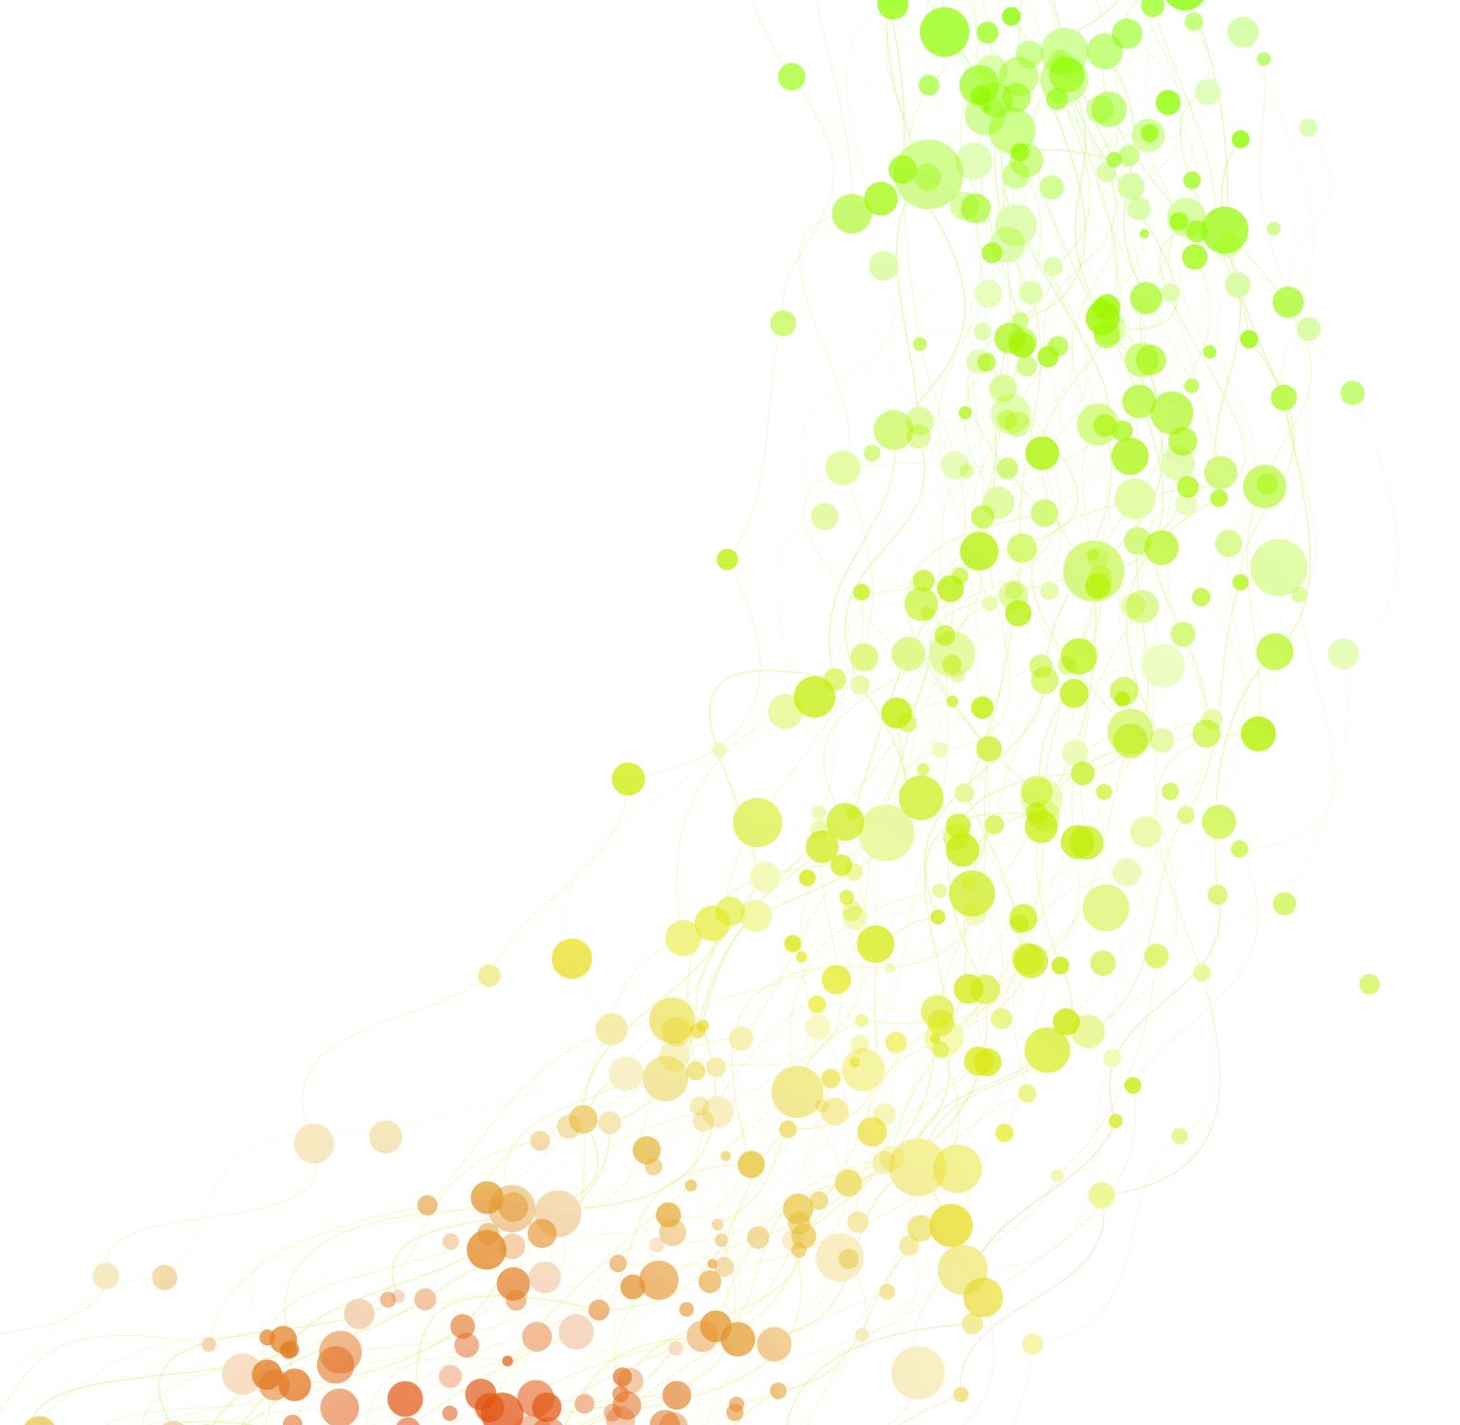
Pressure Sores (60 minutes)

Slide 2
Opinion
“If a patient develops bedsore, it’s generally not the fault of the disease, but of the nursing”- Florence Nightingale
Do you agree with this statement? And why?
Post your response in the Chat Box/ unmute the microphone and speak

Slide 3
Discussion
A 76-year-old man is bedridden following a major stroke. He is unconscious and is on nasogastric feeding and has urine and faecal incontinence.
Discuss the situation and suggest interventions to prevent bedsores
Discuss in groups (10 minutes). Report back ( 5 minutes)

Slide 4
Pressure-induced skin and soft tissue injury
Pressure-induced skin and soft tissue injury (Pressure Sores) are localized areas of tissue necrosis that tend to occur when soft tissue is compressed between a bony prominence and an external surface for a prolonged period.
The sore is caused by constant, unrelieved pressure on the skin and underlying tissue.
The pressure comes from outside the body.

Slide 5
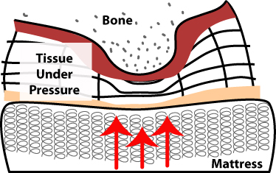
Pathophysiology
Pressure slows the blood flow to an area which leads to tissue death
“Friction” and “shear” can add to the problem

Slide 6
Causative Factors - Extrinsic
Pressure: Restriction of blood flow when skin and the underlying tissues are trapped between bone and a hard surface
Friction: Resistance to the skin when body sliding or rolling over another surface it is in contact with.
Shear: Occurs when skin moves in one direction, and the underlying bone moves in another; e.g. sliding down in a bed or chair.
Strain: Tissue deformation in response to pressure

Slide 7
Risk Factors - Intrinsic
Age. Older adults have thinner skin, less natural cushioning over bones and poor nutrition
Lack of pain perception. Eg, Spinal cord injuries
Malnutrition
Urinary or faecal incontinence. Moist skin can break down easily. Bacteria from faecal matter can cause infections
Diseases conditions affecting circulation (diabetes mellitus, vascular diseases) / Smoking (Nicotine impairs circulation and reduces the amount of oxygen in the blood)
Decreased mental awareness by disease, trauma or medications

Slide 8
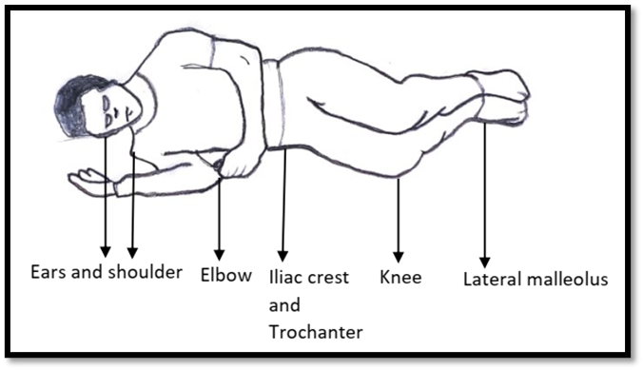
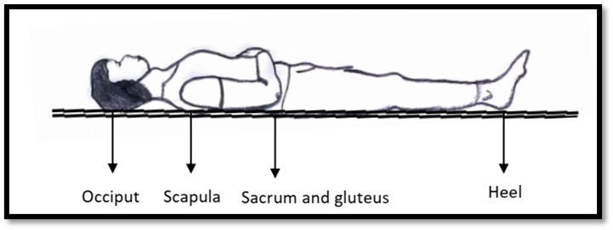
Pressure sores are seen at pressure points

Slide 9
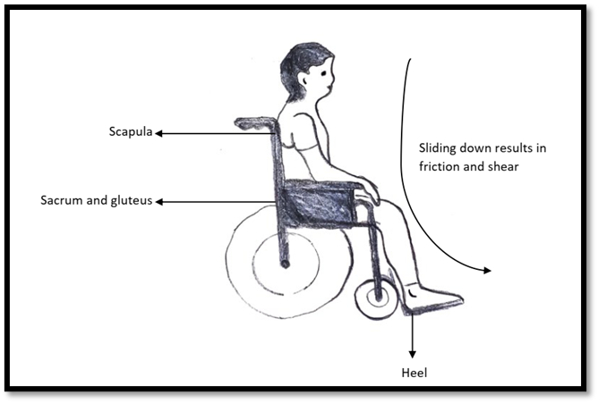
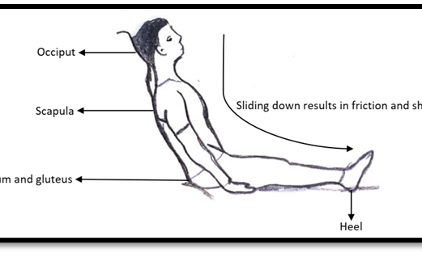
Pressure Points

Slide 10
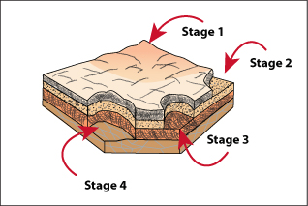
Pressure Ulcer - Stages
Pressure ulcers are graded/ “staged” as Stage 1, Stage 2, Stage 3, and Stage 4 to indicate the amount of tissue damage

Slide 11
Pressure Sore – Stage 1
Most superficial
An area of skin that is noticeably different from the surrounding area.
It may look red, and the redness is not blanchable (does not fade when the skin is pressed and released)
May be painful

Slide 12
Pressure Sore – Stage 2
Superficial ulcer as blister or abrasion
Epidermis damaged
Dermis is exposed
No granulation tissue, no slough, and no eschar

Slide 13
Pressure Sore – Stage 3
The full thickness of the skin is lost
The subcutaneous tissue is exposed
The wound appears as a deep crater
The granulation tissue, slough, or eschar may be present, making it difficult to stage

Slide 14
Pressure Sore – Stage 4
The muscles, bones, and tendons lay exposed
The ulcer is a deep crater
The granulation tissue, slough, or eschar may be present making it difficult to stage

Slide 15
Pressure Sore – Unstagable
To stage a pressure sore, one needs to visualise the base of the wound.
When the base of the wound is covered by slough or eschar, then the pressure sore is called an unstageable pressure sore.
Once the slough is removed the pressure sore is usually stage 3 or stage 4

Slide 16
Prevention of Pressure Sores
Regular Position change:
Support surfaces
Ensure adequate Nutrition
Manage incontinence
Regular Exercise
Ensure Hygiene
Avoid vigorous massages on the bony prominence and reddened areas
Regular assessment for skin changes.
Control infection

Slide 17
Position Change
Periodic and regular position change is crucial to protect the patient from developing pressure sores and to promote healing for the patient who has already developed a pressure sore,
Position should be changed every 2 hours for the lying patient
Position must be changed every 15 minutes if the patient is sitting/confined to a wheelchair

Slide 18
Support Surfaces
Air bed and waterbed to reduce the pressure exerted on the bony prominences
Not a substitute for regular position changes.
Gloves filled with water can be placed below the Achilles tendon to prevent pressure injury at the heel.
Ensure that the bedding is wrinkle-free to prevent superficial skin abrasions.

Slide 19
Adequate Nutrition
Ensure food intake with 30 to 35 Cal/kg/day energy and 1.5g/kg/day of protein

Slide 20
Manage incontinence
Regularise bowel routine
Ensure proper drainage of urine

Slide 21
Regular Exercise
Active and/ or passive exercise to help in maintain muscle mass and promote circulation
Exercise significantly reduces the risk of developing pressure sores.

Slide 22
Hygiene
Maintain the skin clean and dry
Use emollients regularly to reduce friction exerted on the skin.
Daily back care and bed bath with warm water to promote circulation
Avoid vigorous massages on the bony prominence and reddened areas

Slide 23
Regular assessment for skin changes
Check the skin every time someone helps the patient to the toilet, dress, bathe, transfer, and turn a bedridden patient.
Look for areas of skin noticeably different from the surrounding area
A “suspicious area” may feel "spongy“/ "raised“/ warmer/ colder than the surrounding areas

Slide 24
Diagnose infection early
The diagnosis of wound infection is a clinical diagnosis and not a microbiological diagnosis as almost all wounds are colonized by bacteria.
Signs of wound infection.
Erythema around the wound
Increased warmth
Increased tenderness
Foul-smelling, thick, purulent discharge
Fever

Slide 25
Infections
Local application of Metronidazole (powder/gel).
Daily dressing the bedsore with saline and metronidazole tablets crushed into powder (or gauze soaked in metronidazole IV solution) will be effective
Works effectively against foul smell producing anaerobic organisms.

Slide 26
Thank you!

